Slide 1


Naviotech Solutions
Minor Project Report
Internship Domain: Web Development
Organization: Naviotech Solution
Submitted By: Ishant Lingwal

Slide 2
ABSTRACT
Content:
This project focuses on the development of a Task Manager Web Application that helps users manage daily tasks efficiently.
Users can register, log in, add tasks with deadlines, mark tasks as completed, and delete tasks.
The application is developed using basic web technologies and follows a client-server architecture, providing hands-on experience in full-stack web development.
01

Slide 3
Project Goals
    To design and develop a web-based task management application
    To allow users to register and log in securely
    To enable users to add, view, update, and delete tasks
    To manage tasks with deadlines and completion status
    To understand frontend–backend interaction using Node.js
03

Slide 4
FEATURES OF THE APPLICATION
    USER REGISTRATION AND LOGIN SYSTEM
    SHOW / HIDE PASSWORD OPTION
    ADD TASKS WITH DEADLINES
    SHOW TASK PENDING OR COMPLETE
    DELETE TASKS
    USER-SPECIFIC TASK MANAGEMENT
04

Slide 5
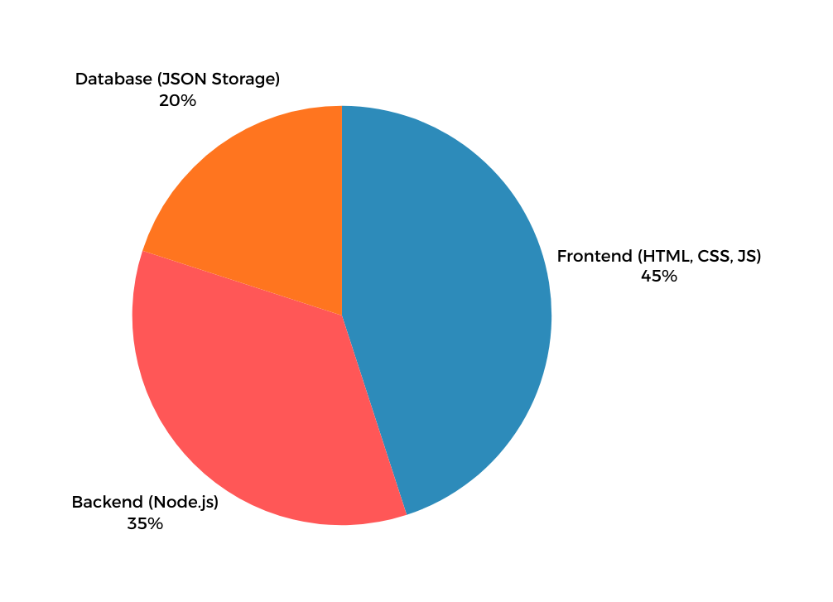
TOOLS & TECHNOLOGIES USED
05

Slide 6
SYSTEM ARCHITECTURE
    The Task Manager Web Application follows a client-server architecture.
    The frontend sends HTTP requests to the backend server.
    The backend processes requests and stores user-specific data in a JSON file.
    Each user has a separate task list ensuring proper data handling.
FRONTEND → BACKEND → JSON DATABASE
06

Slide 7

IMPLEMENTATION
    User Authentication
    Users register using username and password
    Login credentials are verified before access
    Task Management
    Add new tasks with deadlines
    View task list
    Mark tasks as completed
    Delete tasks
07

Slide 8
How to Run the Application
  Install Node.js on the system
  Download and extract the project files
  Open the project folder in Command Prompt / Terminal
  Start the backend server using the command:
node .\server.js
  Server starts running on localhost
  Open a web browser to access the application

Slide 9


RESULTS & CHALLENGES
    Handling case-sensitive usernames
    Debugging frontend-backend communication
    Managing JSON file errors
    APPLICATION PERFORMS ALL TASK OPERATIONS SUCCESSFULLY
    User data is stored and handled properly
    Clean and simple user interface
08

Slide 10

CONCLUSION & FUTURE SCOPE
The Task Manager Web Application fulfills all the requirements of a minor internship project.
It demonstrates understanding of frontend and backend development and task management.
Its future scope are Below:-
    Password encryption
    Database integration (MySQL / MongoDB)
    Task priority system
    Responsive UI design
09

Slide 11
THANK YOU

